Slide 2
phospholipid bilayer | /ˌfɒsfəˈlɪpɪd/ /ˈbɑɪˌleɪə(r)/ | 磷脂双分子层
fluid mosaic model | /moʊˈzeɪɪk/ | 流动镶嵌模型
cholesterol | /kəˈlestərɔːl/ | 胆固醇
glycolipid | /ˌɡlaɪkəˈlɪpɪd/ | 糖脂
glycoprotein | /ˌɡlaɪkoˈproˌtin/ | 糖蛋白
endocytosis | /ˌendoʊsaɪˈtoʊsɪs/ | 胞吞
receptor |  | 受体
ligand | /ˈlɪɡənd/ | 配体
integral/intrinsic protein | /ˈɪntɪɡrəl/ /ɪnˈtrɪnzɪk/ | 整合/内在蛋白
peripheral/extrinsic protein | /eksˈtrɪnzɪk/ | 外在/外周蛋白
Channel protein |  | 通道蛋白
Carrier protein |  | 载体蛋白

Slide 3
cell signalling | /sel ˈsɪɡnəlɪŋ/ | 信号传递
second messenger |  | 第二信使
G protein-coupled receptors |  | G蛋白偶联受体
signal transduction | /trænsˈdʌkʃn/ | 信号转导
amplification | /ˌæmplɪfɪˈkeɪʃn/ | 放大
cascade amplification | /kæˈskeɪd/ | 级联放大

Slide 5
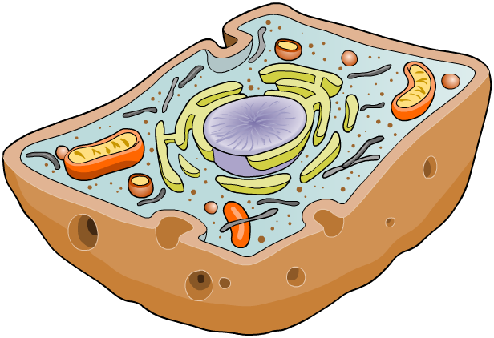

What are membranes?
Membranes cover the surface of every cell, and also surround most organelles within cells. They have a number of functions, such as:
keeping all cellular components inside the cell
allowing selected molecules to move in and out of the cell
isolating organelles from the rest of the cytoplasm, allowing cellular processes to occur separately.
a site for biochemical reactions
allowing a cell to change shape.

Slide 6

Membranes: timeline of discovery

Slide 7

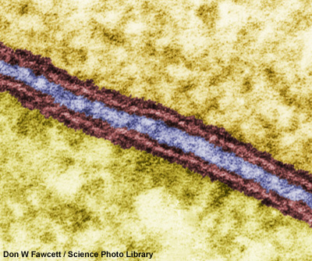
Evidence for the Davson–Danielli model
Later, it was discovered that the light layer represented the phospholipid tails and the dark layers represented the phospholipid heads.
intracellular space (blue)
The bilayer (membrane) is about 7 nm wide.
1st cell membrane
1 light layer = phospholipid tails
2 dark layers: phospholipid heads
2nd cell membrane
Notes:
Photo credit: Don W Fawcett / Science Photo Library
Colour-enhanced transmission electron micrograph (TEM) of the unit membranes of two adjacent cells.
Teacher notes
See the ‘Cell Structure’ presentation for more information about electron microscopy.

Slide 8
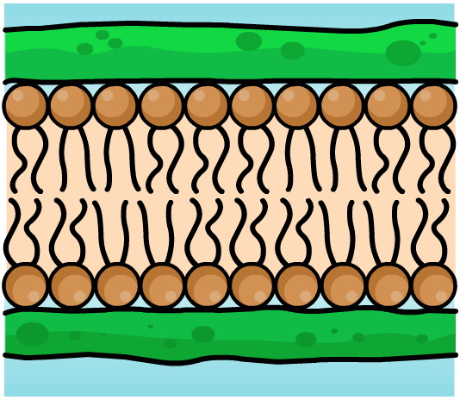
Problems with the Davson–Danielli model
By the end of the 1960s, new evidence cast doubts on the viability of the Davson–Danielli model.
The amount and type of membrane proteins vary greatly between different cells.
It was unclear how the proteins in the model would permit the membrane to change shape without bonds being broken.
Membrane proteins are largely hydrophobic and therefore should not be found where the model positioned them: in the aqueous cytoplasm and extracellular environment.

Slide 9
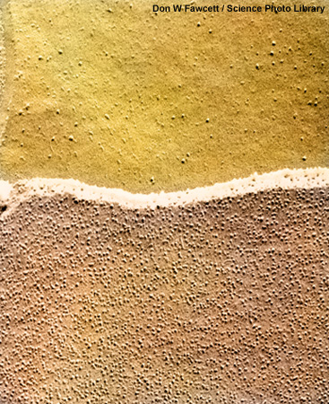
Evidence from freeze-fracturing
In 1966, biologist Daniel Branton used freeze-fracturing to split cell membranes between the two lipid layers, revealing a 3D view of the surface texture.
This revealed a smooth surface with small bumps sticking out. These were later identified as proteins.
E-face: looking up at outer layer of membrane
P-face: looking down on inner layer of membrane
Notes:
Photo credit: Don W Fawcett / Science Photo Library
Colour-enhanced scanning electron micrograph (SEM) of a freeze-fracture preparation of epithelial cell membranes, showing the P-face and the E-face.
Teacher notes
Freeze-fracturing (or freeze-etching) is a technique developed in the 1950s for preparing specimens for electron microscopy. The sample to be studied is rapidly frozen in liquid nitrogen then tapped so it fractures along a line of weakness – for example, along the middle of a phospholipid bilayer. The exposed surfaces are then ‘etched’ with heavy metals so they can be seen by electron microscopy.

Slide 10
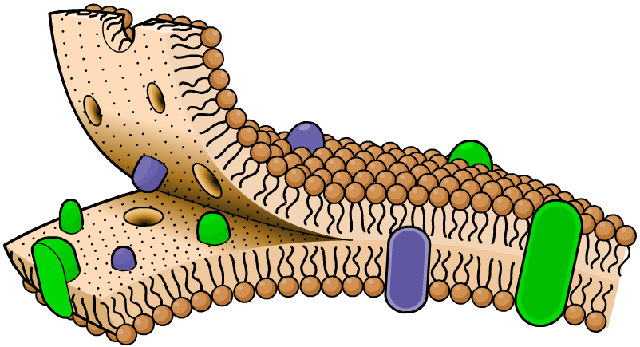
The fluid mosaic model
The freeze-fracture images of cell membranes were further evidence against the Davson–Danielli model.
E-face
They led to the development of the fluid mosaic model, proposed by Jonathan Singer and Garth Nicholson in 1972.
P-face
protein
This model suggested that proteins are found within, not outside, the phospholipid bilayer.

Slide 11
Exploring the fluid mosaic model

Slide 12
Membrane models: true or false?

Slide 14
Components of the membrane

Slide 15
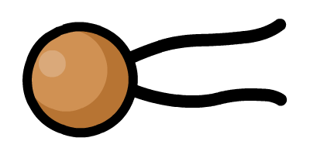
What are phospholipids?
One of the main components of membranes are phospholipids, a type of lipid made from two fatty acid chain ‘tails’ attached to a phosphate group ‘head’.
The phosphate group head is polar and hydrophilic (‘water-loving’), while the fatty acid chains of the tail are non-polar and hydrophobic (‘water-hating’).
hydrophilic head
hydrophobic tails
The shape of the structures that phospholipids form is due to their polar nature, and the way they interact with water.
Notes:
Teacher notes
See the ‘Biological Molecules: Proteins and Lipids’ presentation for more information about phospholipids.
Lipids make up around 45% by mass of a cell membrane.

Slide 16
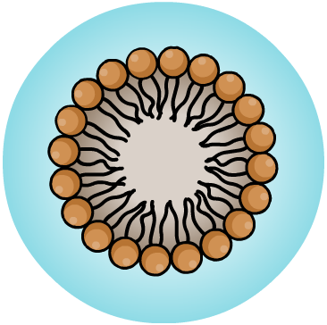
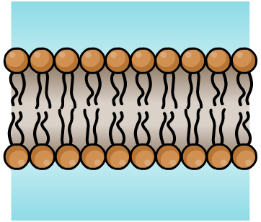
Phospholipids in water
When exposed to water, phospholipids form one of two structures: a micelle胶束 or a bilayer.
micelle
bilayer
In each structure, the hydrophilic heads face the water, and the hydrophobic tails point inwards away from the water.
This behaviour is key to the role that phospholipids play in membranes.

Slide 17
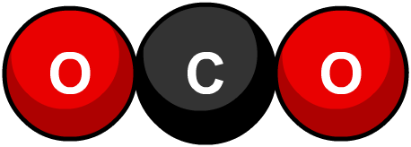
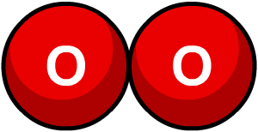
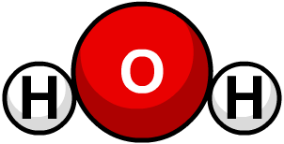
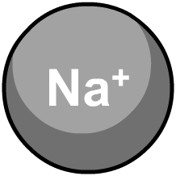
Phospholipids in membranes
The role of phospholipids in membranes is to act as a barrier to most substances, helping control what enters/exits the cell.
Generally, the smaller and less polar a molecule, the easier and faster it will diffuse across a cell membrane.
Small, non-polar molecules such as oxygen and carbon dioxide rapidly diffuse across a membrane.
Small, polar molecules, such as water and urea, also diffuse across, but much more slowly.
Charged particles (ions) are unlikely to diffuse across a membrane, even if they are very small.
Notes:
Teacher notes
See the ‘Transport Across Membranes’ presentation for more information about diffusion.

Slide 18
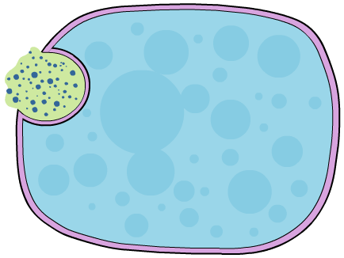
Membrane fluidity
It is important that a cell membrane maintains its fluidity otherwise the cell would not be able to function.
A fluid membrane is needed for many processes, such as for:
the diffusion of substances across the membrane
membranes to fuse, e.g. a vesicle fusing with the cell membrane during exocytosis
cells to move and change shape, e.g. macrophages during phagocytosis.

Slide 19
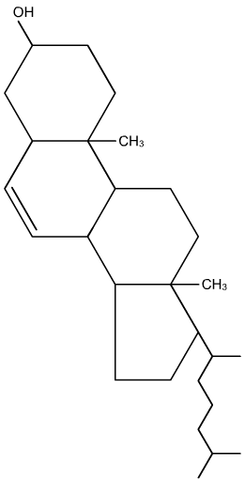
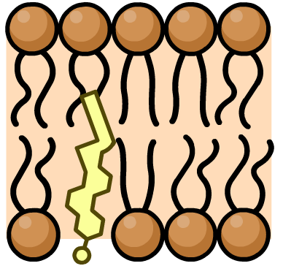
Cholesterol in cell membranes
Cholesterol is a type of lipid with the molecular formula C₂₇H₄₆O.
Cholesterol is very important in controlling membrane fluidity. The more cholesterol, the less fluid – and the less permeable – the membrane.
Cholesterol is also important in keeping membranes stable at normal body temperature – without it, cells would burst open.

Slide 20
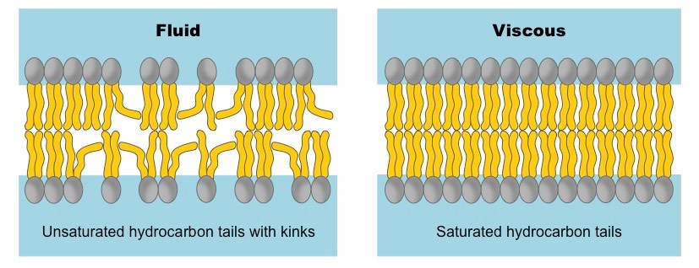
saturation and length of lipid tails
1) tail length – longer the tail, the less fluid the membrane
2) saturation of fatty acid – the more unsaturated they are, the more fluid the membrane.
This is as unsaturated fatty acid tails are bent and fit together
more loosely

Slide 21
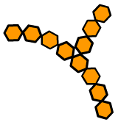
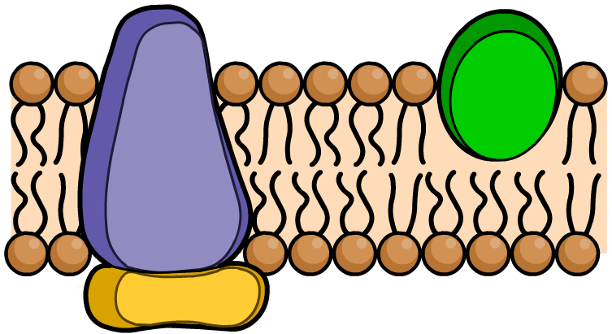
Proteins in membranes
Proteins typically make up 45% by mass of a cell membrane, but this can vary from 25% to 75% depending on the cell type.
Integral (or intrinsic, or transmembrane) proteins span the whole width of the membrane.
carbohydrate chain
integral protein
Peripheral (or extrinsic) proteins are confined to the inner or outer surface of the membrane.
peripheral protein
Many proteins are glycoproteins – proteins with attached carbohydrate chains.

Slide 22
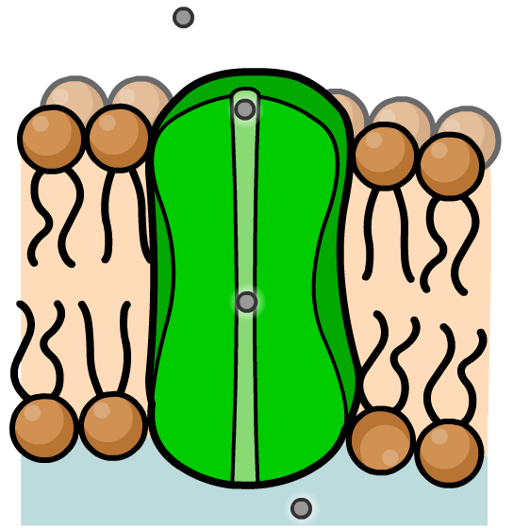
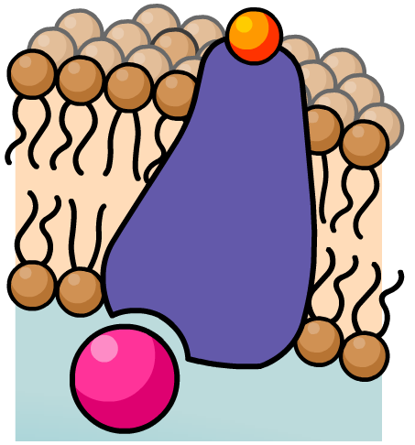
Integral proteins
Many integral proteins are carrier molecules or channels.
These help transport substances, such as ions, sugars and amino acids, that cannot diffuse across the membrane but are still vital to a cell’s functioning.
Other integral proteins are receptors for hormones and neurotransmitters, or enzymes for catalyzing reactions.

Slide 23
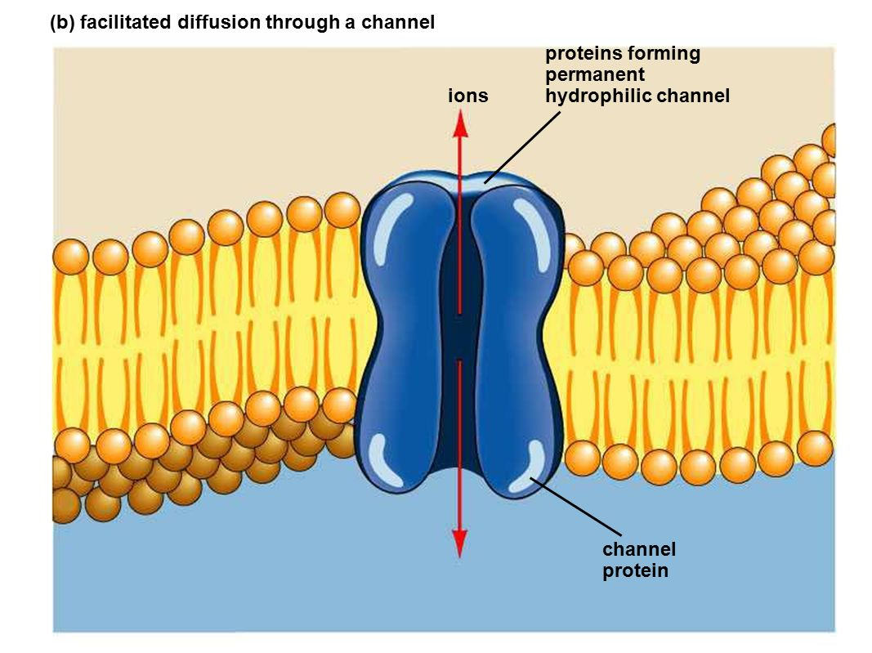
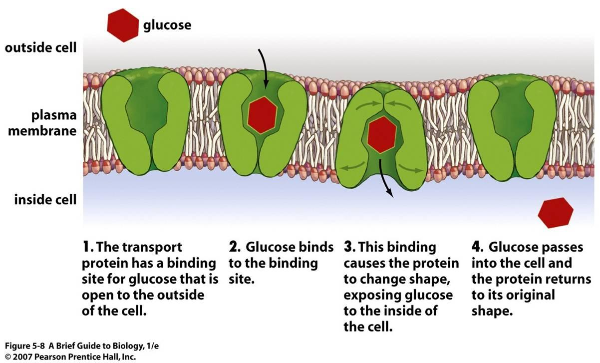
Transport protein（integral）
Transport proteins are highly specific, allowing only one type of molecule or ion to pass through it.
Channel proteins like a gate, and have a fixed shape.
Carrier proteins can ﬂip between two shapes.

Slide 24
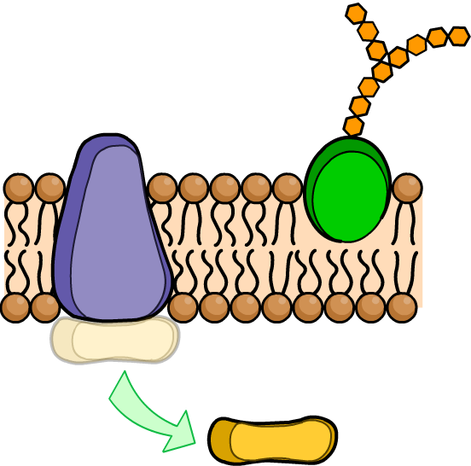
Peripheral proteins
Peripheral proteins may be free on the membrane surface or bound to an integral protein.
Peripheral proteins on the extracellular side of the membrane act as receptors for hormones or neurotransmitters, or are involved in cell recognition. Many are glycoproteins.
Peripheral proteins on the cytosolic side of the membrane are involved in cell signalling or chemical reactions. They can dissociate from the membrane and move into the cytoplasm.

Slide 25
Glycolipids and glycoproteins
glycolipids and glycoproteins：Lipid and protein molecules on the outer surfaces of cell membrane have carbohydrate chains attached
These carbohydrate chains projecting out like antennae:binding/recognizing site
• stabilise the membrane structure by forming hydrogen bonds with water molecules surrounding the cell
• act as receptor molecules:
signalling receptors – recognise messenger molecules like hormones and neurotransmitters
• act as cell markers/antigens allowing cell-cell recognition：ABO blood type

Slide 26
Functions of membrane components

Slide 27
Factors affecting membrane fluidity
Notes:
Teacher notes
This activity assumes that students are familiar with the general structure of lipids, and the difference between saturated and unsaturated fatty acid chains.
See the ‘Biological Molecules: Proteins and Lipids’ presentation for more information about lipids.

Slide 28
Cell membranes

Slide 30
Glossary

Slide 31
What’s the keyword?

Slide 32
Multiple-choice quiz

